Slide 1


K. RAMAKRISHNAN COLLEGE OF ENGINEERING
(AUTONOMOUS), SAMAYAPURAM - TRICHY
DEPARTMENT OF INFORMATION TECHNOLOGY
CGB1201 – JAVA PROGRAMMING
EXPENSE SPLITTER WITH DEBT SIMPLIFICATION
PRESENTED BY:
ALAGAPPAN K
8115U25IT005
KEVIN XAVIER F
8115U25IT056
SUPERVISOR
Mrs.S.SATHYA PRIYA,M.E., (Ph.D.,)
Assistant Professor / IT

Slide 2

PRESENTATION OVERVIEW
1.Project Objective
2. Problem Statement
3. Architecture Diagram
4. Modules Used
5. References

Slide 3
PROJECT OBJECTIVE
Track Expenses: Record and manage shared expenses among group members in real time.
Split Costs: Automatically divide expenses fairly among participants based on the chosen split method.
Simplify Debts: Minimize the number of transactions needed to settle all balances among members.
Generate Reports: Provide users with clear summaries of who owes whom and how much.

Slide 4
PROBLEM STATEMENT
When groups of friends, roommates, or colleagues share expenses, calculating who owes what quickly becomes confusing and error-prone. Multiple pending payments between the same people lead to unnecessary transactions and disputes. This system records shared expenses, splits costs automatically, and simplifies debts by minimizing the transactions needed to settle balances.

Slide 5
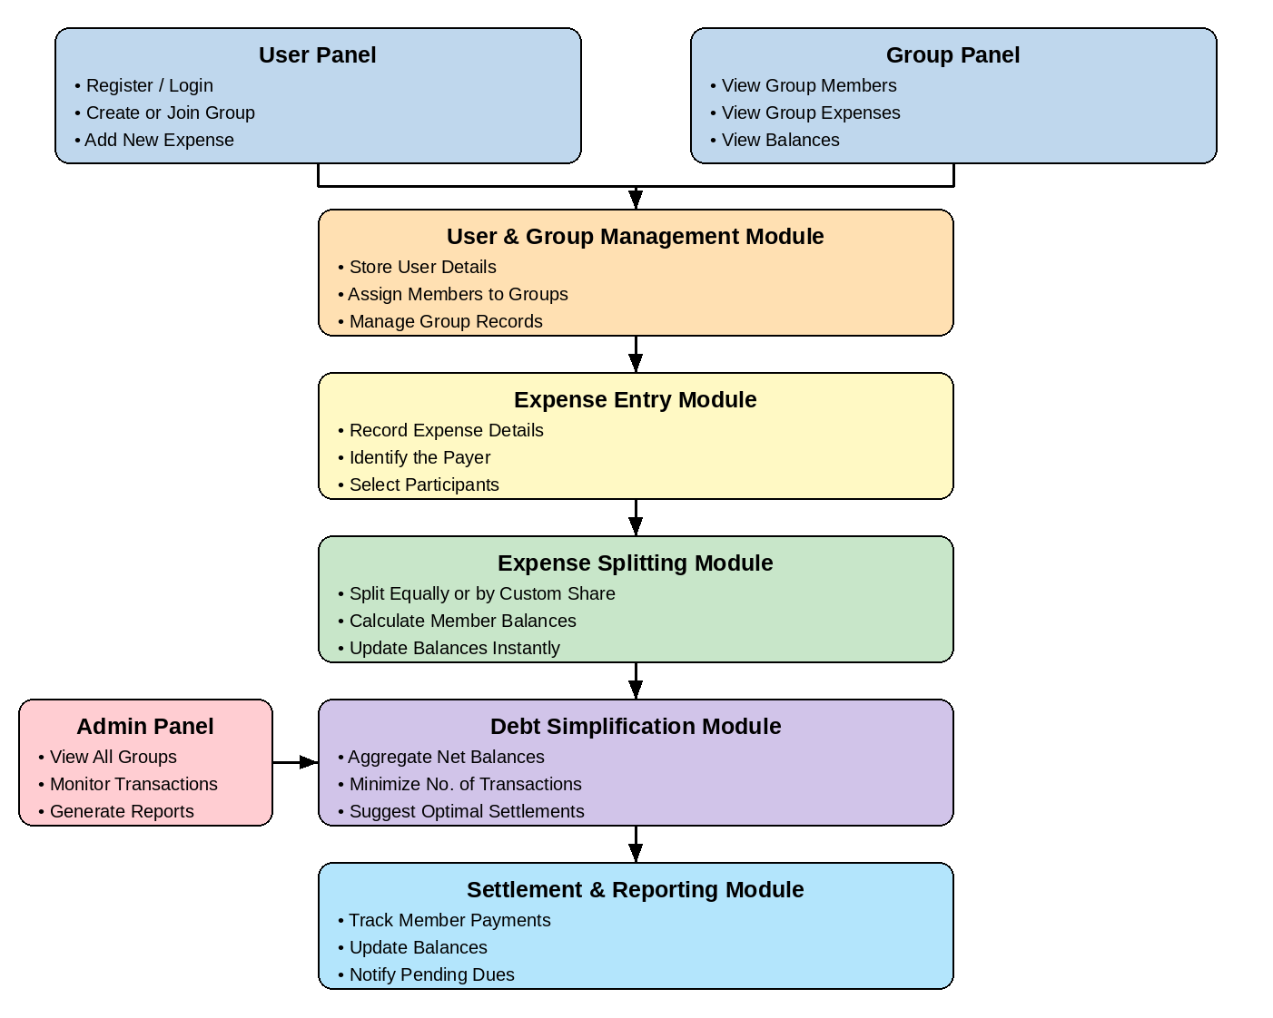
ARCHITECHTURE DIAGRAM

Slide 6
MODULES USED
User & Group Management Module – Manages user profiles and organizes users into expense-sharing groups.
Expense Entry Module – Records new expenses and captures the payer, amount, and participants involved.
Expense Splitting Module – Divides each expense among participants using equal, percentage, or custom split methods.
Debt Simplification Module – Minimizes the total number of transactions needed to settle all outstanding balances.
Settlement & Reporting Module – Tracks payments, updates balances, and generates clear settlement summaries.

Slide 7
MODULE AND ITS DESCRIPTION
MODULE I - USER & GROUP MANAGEMENT MODULE
User Registration: Creates and stores user details such as user ID and name.
User Management: Maintains and manages the details of all users in the system.
Group Creation: Creates an expense-sharing group and organizes users within the group.
Member Management: Adds and displays group members for managing shared expenses.

Slide 8
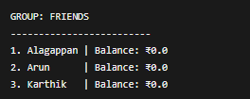
MODULE IMPLEMENTATION
MODULE I - USER & GROUP MANAGEMENT MODULE
OUTPUT

Slide 9
MODULE AND ITS DESCRIPTION
MODULE II - EXPENSE ENTRY MODULE
Expense Recording: Records each new expense along with the amount, date, and category.
Payer Identification: Identifies which group member paid for the expense.
Participant Selection: Allows the payer to select which group members share the expense.
Expense History: Maintains a complete history of past expenses for each group.

Slide 10
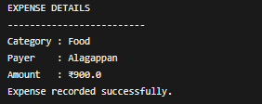
MODULE IMPLEMENTATION
MODULE II - EXPENSE ENTRY MODULE
OUTPUT

Slide 11
MODULE AND ITS DESCRIPTION
MODULE III - EXPENSE SPLITTING MODULE
Split Calculation: Calculates each participant's share based on equal, percentage, or custom split rules.
Automatic Processing: Updates each member's balance automatically whenever a new expense is added.
Balance Checking: Compares what each member owes against what they have already paid.
Share Identification: Identifies each member's exact owed or owing amount for every expense.

Slide 12
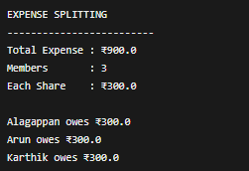
MODULE IMPLEMENTATION
MODULE III - EXPENSE SPLITTING MODULE
OUTPUT

Slide 13
MODULE AND ITS DESCRIPTION
MODULE IV - DEBT SIMPLIFICATION MODULE
Balance Aggregation: Combines all individual dues to determine each member's net balance.
Transaction Minimization: Applies a greedy settlement algorithm to reduce the number of payments needed.
Optimal Matching: Matches debtors and creditors so balances are settled with the fewest transfers.
Settlement Suggestion: Recommends who should pay whom and how much to clear all dues.

Slide 14
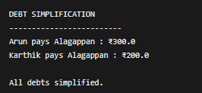
MODULE IMPLEMENTATION
MODULE IV - DEBT SIMPLIFICATION MODULE
OUTPUT

Slide 15
MODULE AND ITS DESCRIPTION
MODULE V - SETTLEMENT & REPORTING MODULE
Payment Tracking: Records settlement payments made between members to clear their balances.
Balance Updating: Updates each member's balance immediately after a settlement is recorded.
Report Generation: Generates clear summaries showing who owes whom and how much.
Due Notification: Notifies members of pending dues until every balance is fully settled.

Slide 16
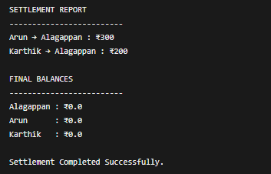
MODULE IMPLEMENTATION
MODULE V - SETTLEMENT & REPORTING MODULE
OUTPUT

Slide 17
FUTURE IMPLEMENTATION
Database Integration
  - Store user details, expenses, balances, and settlement records permanently.
Multiple Split Options
  - Support equal, percentage-based, and custom expense splitting.
User-Friendly Interface
  - Develop a simple GUI so users can enter expenses and view balances easily.
Expense History
  - Allow users to view previous expenses and completed settlements.
Automated Due Notifications
  - Notify members when they have pending payments or unsettled balances.

Slide 18
REFERENCE
OracleJavaDocumentation
  https://docs.oracle.com/en/java/⁠
Mysql Documentation
  https://dev.mysql.com/doc/⁠
W3Schools – Java Tutorial
  https://www.w3schools.com/java/⁠
GeeksforGeeks
    https://www.geeksforgeeks.org/⁠
Google Scholar – Research Papers
  https://scholar.google.com/⁠

Slide 19


